Slide 1
Three reports, one quick read
Here's the short version of what your team did: the solar data dive, the Mustafar rocket flights and the asteroid-mining pitch.
At first glance these three projects have nothing to do with each other. Look a little closer and there's a common thread: sunlight, gravity and distance set the rules, and good engineering mostly means working with them instead of fighting them. Here's what each report set out to do, and what it turned up.
The three at a glance
Report The big question How it digs What came out
1. Solar radiation analysis
What really drives sunlight at ground level, and when is the best time to catch it?
Correlations and a Random Forest model on 32,686 weather-station readings (Sep to Dec 2016)
Sunlight peaks around noon at roughly 727 W/m², and the model explains 93% of the ups and downs (R² = 0.9304)
2. Mustafar rocket report
How does the same rocket fly on Earth versus on Mustafar?
Two OpenRocket 6-DOF simulations that differ only in the environment
It climbs about twice as high (1,922 m to 3,929 m) and stays in the air 48% longer
3. Orbital Fuel
How could asteroid mining ever pay for itself?
A pitch deck covering engineering, cost and business
Mine selectively, haul less waste, sell water in space, and only scale up once the numbers add up
What stuck with me
Where the sun sits beats everything else. Let a model decide what matters and time of day takes about three quarters of the credit. Humidity is a distant second at around 11%, quietly dimming the light.
Daily averages can fool you. Two days can average out the same and still behave nothing alike. A broken-cloud day can throw brief spikes past 1,500 W/m², and that's exactly what a grid or inverter has to survive.
Less gravity and thinner air change everything at once. On Mustafar the rocket flies much higher, but it also comes down 46% faster under the same parachutes and wanders about 1.7 km further from the launch site.
The mining deck wins by being choosy, not big. Survey before you dig, process at the asteroid so you're not hauling rock, sell water where launching it costs the most, and only grow once revenue beats the cost of running the whole thing.
Where to look
Page What you'll find
2
The solar story: what was measured, what the model learned, and what to do with it
The Mustafar flights: setup, full results, and how the prediction held up
Orbital Fuel, part one: how the spacecraft works and where the money goes
Orbital Fuel, part two: who pays, what could go wrong, and the road to profit

Slide 2
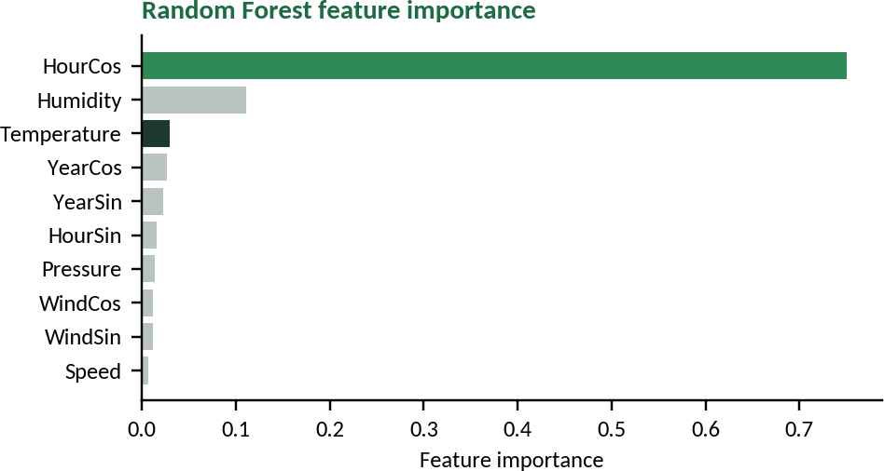
Solar radiation: when the sun really delivers
A few months of weather-station readings (September to December 2016), and one question: when, and why, does the sun deliver most?
Where it started. The team began with 32,686 readings and set aside any with missing timestamps or radiation values, so nothing shaky got into the results. 26,148 readings were used to train the model and 6,538 held back to test it.
Temperature, humidity, pressure and wind were each compared against sunlight.
Who moves with the sun
Factor | r | Strength | In plain words
Temperature | +0.735 | Strong, positive | Rises with the sun, so it tracks sunlight closely
Relative humidity | -0.523 | Moderate, negative | Moisture and cloud steal some of the direct light
Pressure | +0.314 | Weak, positive | High pressure usually brings clearer skies
Wind speed | +0.174 | Slight, positive | Picks up around the midday heat
Wind direction | -0.091 | Negligible | Basically doesn't care
What the numbers are saying
Sunlight is zero overnight, climbs after dawn, peaks between 12 and 1 PM and then fades the same way it came, a tidy bell curve. The best hourly average is 727.47 W/m².
Humidity works like a lid. On dry days radiation can reach its maximum; once humidity creeps past about 60%, it drops off sharply.
A sensor having a bad day. Daily average humidity comes out at 101.17% on 29 Oct and 101.11% on 30 Oct, which can't happen in real life. Rain or dew most likely confused the probe.
The twist. The day with the single biggest spike wasn't the day with the best average. Peaks above the solar constant (about 1,361 W/m²) turn up on partly cloudy days, when bright cloud edges bounce extra light onto the sensor. Inverters and grid controllers have to be ready for those surges.
So what do we do with this? Aim single-axis trackers at the 11 AM to 2 PM window, and let air flow behind the panels, because hot cells lose efficiency.
How well the model did
Measure Result
Algorithm Random Forest
_{R}2
0.9304 (93.04%)
RMSE 83.16 W/m²
Top feature HourCos, 0.7505
Second Humidity, 0.1107
Third Temperature, 0.0297

Slide 3
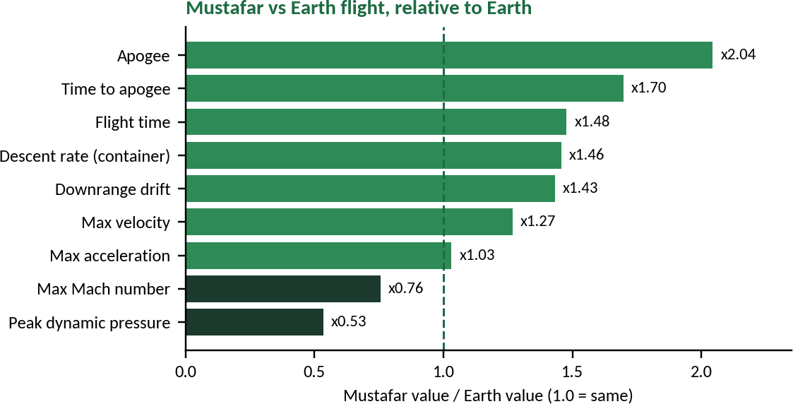
Mustafar: the same rocket under a very different sky
Same rocket, same motors, same wind. Only the world underneath it changed.
The rocket: a 6.88 kg aluminium-bodied rocket carrying a 1 kg payload, with a Contrail J416-SP booster and a Cesaroni 567I125-10A sustainer. Stage separations, parachute events and the 10 m/s wind from 270 degrees were identical in both OpenRocket runs, so any difference comes down to the environment.
Environment | Earth | Mustafar | Change
Gravity | 9.79 m/s² | 6.50 m/s² | -34%
Surface pressure | 101.3 kPa | 75 kPa | -26%
Surface temperature | 288 K | 700 K | +412 K
Air density | 1.225 kg/m³ | 0.373 kg/m³ | -70%
So what happened?
Quantity | Earth | Mustafar |  | Change
Apogee | 1,922 m | 3,929 m |  | x2.04
Time to apogee | 19.8 s | 33.6 s |  | x1.70
Maximum velocity | 206.7 m/s | 261.9 m/s |  | +27%
Maximum Mach number | 0.626 | 0.473 |  | -24%
Maximum acceleration | 104.6 m/s² | 107.9 m/s² |  | +3.3 m/s²
Peak dynamic pressure | 24.3 kPa | 13.0 kPa |  | -46%
Stability margin (low / high) | 1.97 / 4.58 cal | 1.87 / 4.56 cal |  | about the same
Descent rate, container / sustainer | 3.65 / 3.61 m/s | 5.32 / 5.25 m/s |  | x1.46 / x1.45
Downrange drift (container / sustainer) | 4.10 / 4.16 km | 5.87 / 5.97 km |  | x1.43
Flight time (container) | 532 s | 786 s |  | x1.48
Speed at parachute deployment | 40.9 m/s | 39.2 m/s |  | similar
The prediction, and how it held up
Before running anything, the team made a guess: lower gravity means a lighter rocket, so it should accelerate harder, lose less speed to gravity and coast for longer. The numbers backed them up. Weight drops from 67.4 N to 44.7 N, maximum acceleration rose by 3.3 m/s², exactly the drop in gravity, and over the 7.3 s powered phase gravity steals about 72 m/s on Earth but only about 48 m/s on Mustafar.
Put simply: thin air and weak gravity let the rocket climb higher and stay up longer. The flip side is the way down. Thinner air gives the parachutes less to grab, so it lands faster and drifts further.

Slide 4
Orbital Fuel: how it works and what it costs
A six-slide pitch for making asteroid mining actually pay.
How the system works
Job How it's done
Getting there
Solar-electric propulsion for an efficient, fuel-light trip; on arrival, cameras and navigation sensors map the surface, then a slow approach and mechanical anchoring
Water Drill into the ice, heat it in a sealed chamber and capture the vapour
Iron and nickel Pull them out with magnets, then send them to a refinery Platinum-group metals Survey and test first; only extract if the numbers justify it
Processing
Do just enough at the asteroid to cut the mass being hauled, and skip anything that costs more than it saves
Power
Big solar arrays sized for the belt, batteries for peak demand, and mining scheduled around the power available
Comms and autonomy
A high-gain antenna with a low-gain backup and onboard storage. Routine work is handled onboard; the big calls go to Earth
The spacecraft itself is seven modules joined end to end: propulsion, solar power, mining (drills, scoops, material handling), anchoring (SmartGrip), processing (a heating chamber plus metal concentration), storage (sealed water tanks and solid containers), and comms and navigation. In the hand-drawn diagram they sit in a line, with a solar panel at each end and a robotic arm for repairs.
When things break
If this fails The system does this
Drill jam Stop and try a controlled recovery
Anchor slip Pause, reassess, reposition
Power loss Batteries keep essentials alive; non-critical systems switch off
Comms loss Carry on with safe, pre-programmed operations Component failure Isolate the module and rely on critical redundancy
What drives the cost
Big cost How the deck brings it down
1. Launch and transport
Rideshare when trajectories match, an optimised target and launch window, solar-electric propulsion to cut propellant mass, and carrying only the equipment the chosen target needs
2. Mining and processing equipment
Modular multi-task robots, a survey before extracting, concentrating valuable material instead of hauling waste, no full refinery on board, and autonomous monitoring to catch problems early
3. Transport and operations
Separate useful fractions at the asteroid, ship only recovered water and concentrated metal, use autonomous fault detection and safe mode, and share downstream refining with other missions
The test that matters: Profit = Revenue minus Total Costs, counting launch, transport, mining, processing, storage, refining, delivery and maintenance. Only go ahead if the selling price beats the full cost of delivery, with a safety margin. Compared with the conventional approach (a full refinery on board, raw ore shipped home, one destination, heavy chemical-rocket propellant), Orbital Fuel concentrates at the asteroid, hauls less waste and keeps its equipment modular.

Slide 5
Orbital Fuel: who pays, the risks, the plan
What gets sold, and to whom
Resource | Customers | Where it goes
Water ice, purified for life support or propellant | Orbital depots and stations; lunar missions | Sold in space to orbital depots
Iron and nickel, concentrated | Spacecraft companies building in orbit | A shared space-based manufacturing facility
Platinum-group metals, high value | PGM buyers, if the price is competitive | Back to Earth only if the value justifies the trip
The guiding idea is simple: send each resource where it earns the most, instead of shipping everything to one place. That gives three ways to make money. Water goes to depots and other space customers, priced on quantity, purity and an agreed rate. Metal feedstock and components go to a shared processing facility, moving over time toward finished products instead of raw material. And platinum-group metals are sold, as verified concentrate or refined metal, only when assays and delivery costs actually leave a profit.
What could go wrong
Risk How the deck handles it
1. Uncertain resource content Remote surveys, sample analysis and prospecting before big investment
2. High transport and processing costs
Optimise trajectories, concentrate material, compare total delivered cost with alternatives
3. Not enough customer demand
Find customers early, seek purchase commitments, scale only to proven demand
4. Equipment failure
Modular equipment, autonomous fault detection, safe mode and critical redundancy
5. Immature space infrastructure
Start with a small demo mission and expand as infrastructure and customers appear
The road to profit, in six steps
1 | Prospect Find an asteroid and confirm what it holds | 2 | Demonstrate Test small-scale extraction, anchoring and water recovery | 3 | Secure customers Confirm specs, demand and expected prices
4 | Deliver a test batch Prove transport and delivery work | 5 | Validate economics Weigh every cost against what customers will pay | 6 | Scale Expand only when it's reliable and revenue beats lifecycle cost
The deck sums it up well: mine selectively, transport less waste, operate autonomously, and sell where value is greatest.

